Slide 1
Software Engineering
Lesson 2 – Requirement Engineering Life Cycle
LO2 : Carry out a requirements acquisition exercise in order to identify the main functional and non-functional requirements of a proposed software system

Slide 2
Lesson Objectives
Understanding the Requirements Engineering Life Cycle.
Overview of the Requirements Engineering Life Cycle
The Phases of the Engineering Life Cycle
Functional Requirements
Non-Functional Requirements
Different ways of Eliciting Requirements
Group Sessions (JAD)
Interviews
Questionnaires
Prototyping
Observations

Slide 3
The Importance of a Process
Specifying the Requirements may seem simple
However...
Many systems do not meet their users’ need because requirements were not accurately specified.
The reason for this is that a lot of Communication takes place at this stage, therefore there is more chance of misinterpreting what is being said or being misinformed about what is needed.

Slide 4
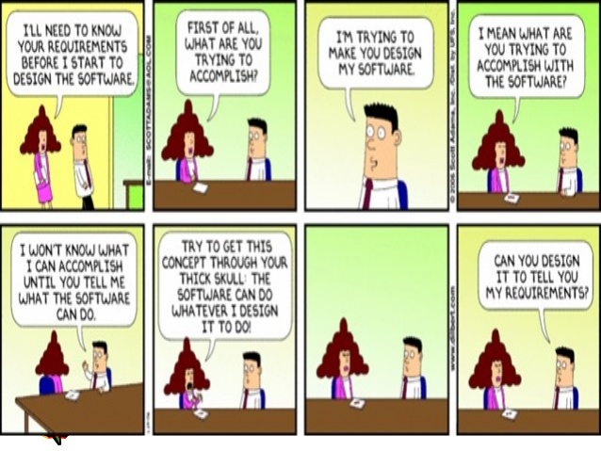
The Importance of a Process
The Client may be ambiguous or not know exactly what he wants!

Slide 5

Discussion
What are the Repercussions of Gathering the Wrong Requirements?

Slide 6
The Importance of a Process
In order to try to minimize the negative impacts of incorrectly specifying requirements, a process is applied in order to carry out this important activity as a series of steps.
This process is known as the Requirements Engineering Life Cycle and contains the following activities:
Requirements Elicitation
Requirements Analysis
Requirements Specification
Requirements Validation
All of the above processes must be managed and documented!

Slide 7
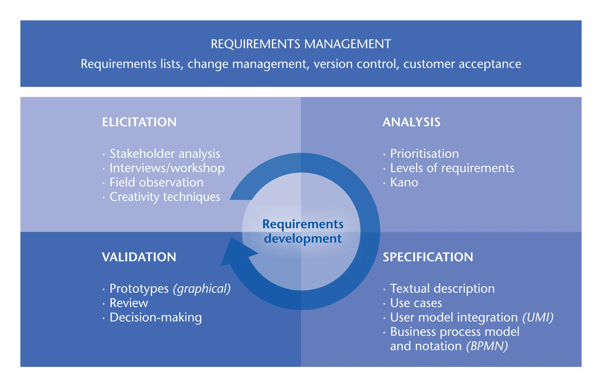
Requirements Engineering Life Cycle

Slide 8
Requirements Engineering Life Cycle
1. Requirements Elicitation
Through interaction with the stakeholders and investigations about the organization and the current system, the analyst builds a model of the domain in which the system will be integrated and understands the given problem. Based on this model, the analyst tries to find out what is required of the new system.
2. Requirements Analysis
At this stage, the requirements are prioritized and verified with the stakeholders to ensure that there are no misunderstandings and misinterpretations and that everyone is on the same page. A risk analysis od the [project is also carried out and estimates for effort, time and cost are also calculated.

Slide 9
Requirements Engineering Life Cycle
3. Requirements Specification
The requirements are understood and described in more detail using a natural language. Requirements are also described using a well known and industry recognized diagrammatic notation such as Business Models and UML Use Case Diagrams. Some prototypes are also created at this stage. The aim here is to describe what is required of the system in the clearest, least ambiguous way possible to avoid misinterpretation of requirements.
4. Requirements Validation
The stakeholders must agree on the set of requirements specified; i.e. they must come to a consensus on what the system should do. Reviews, prototypes are critical at this stage so that requirements can be validated by checking that these are correct in terms of the purpose of the system and verified to make sure that these are stated correctly and clearly understood in the same way by every one involved.

Slide 10
Brain Storming
How Can We Gather Requirements?

Slide 11

Group Sessions (JAD)
JAD stands for Joint Application Development.
The primary aim is to collect requirements from a set of stakeholders simultaneously.
This can help resolve conflicts, or find reason why it cannot be resolved
Face to Face communication and discussion, avoids requirements being too specific and restrictive or too vague and with different interpretations.
JADs have also been known to reduce scope creep a
considerable amount; therefore making sure that the
project stays within its objectives and constraints.

Slide 12

Group Sessions (JAD)
The Key Participants include:
Session Leader
End Users
Managers
Project Sponsor
Development Team
Scribe
JAD Sessions require some planning for them to be successful
A Formal Agenda of the points to be discussed is prepared
Questions are also prepared as with interviews
Ground rules are also set up
Notes:
JAD session leader
This participant is generally trained in group management and facilitation as well as in systems analysis. His role is to sets the agenda for the JAD session and concentrate his efforts so that participants keep to it and the discussion does not go off-track. He also helps explain technical terms.
The session leader remains neutral on issues and does not contribute ideas or opinions and must resolves conflicts and disagreements during the JAD session.
Users
These are the end users of the system, who understand the day-to-day procedures of the system .
Managers
Managers contribute insight into new organizational directions, motivations and organizational impacts of systems; therefore it is important that they are part of the team of participants in a JAD session. They also offer support for requirements in view of the organization’s business goals.
Project Sponsor
A member of High level management; often known as the system owner and provides the finances for the project to be initiated. Sponsors usually attend only the first or last JAD sessions.
System Analysts
In a JAD session, the System Analysts' role is to learn what the client needs from the new system, what is important and what is not. In order not to influence the other participants, active participation from his/her part is limited;
Scribe
This participant is takes notes so that a written record exists of what was discussed during each JAD session.
IS Staff
Their role is to contribute ideas on the technical aspects, limitations and feasibility

Slide 13
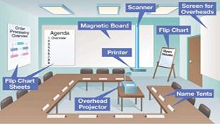
Group Sessions (JAD)
The set up of the room for a JAD session also follows a particular layout to facilitate face to face communication, minimize distractions and provide participants with all necessary tools.
Notes:
U-Shaped seating so that all participants face each other
Whiteboard/flip chart for brainstorming, quick sketches, and diagrams
Prototyping tools t build/modify models of the system on the spot
e-JAD tools to allow for geographically distant participants to join the session

Slide 14
Group Sessions (JAD)
Advantages of using JAD Sessions :
Time is saved, compared with traditional interviewing
Rapid development of systems through discussions
Improved user ownership of the system as everyone feels they have contributed.
Creative idea production is improved
Ideal if users are restless and want something new
Drawbacks of using JAD Sessions :
Requires a large block of time be available for all session participants
If preparation is incomplete, the session may not go very well
If the follow-up report is incomplete, the session may not be successful
The organizational skills and culture may not be conducive to a JAD session
People needing to participate in JAD Session cannot be absent from their job

Slide 15
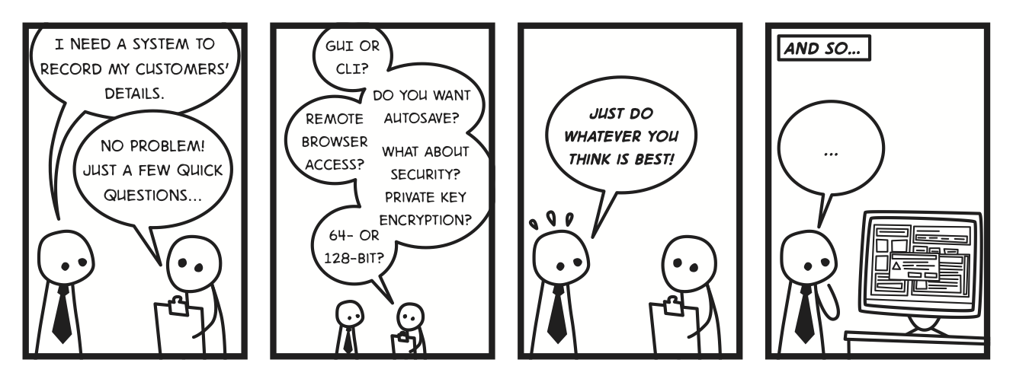
Interviews
A technique used to gather facts, opinions and speculation and observe body language, emotions and other signs of what people want and how they assess current systems.
An ideal investigation technique to reveal information about
Interviewee opinions and feelings • The current state of the system
Organizational and personal goals • Formal and Informal business procedures

Slide 16

Interviews
Interviewing everyone is not feasible, as interviews require time to plan and carry out, it is very important to find the key personnel for each area of investigation.
Asking the right people the right questions will give better chances of obtaining the right information and therefore more chances of eliciting the right requirements.
Key Personnel may include :
System Owners
Information Holders
System Users
Notes:
System Owners
These are the directors, head of the departments; the decision makers in the organization.
These people are ideal to interview to get an overview of the company and also to get an access to interview information holders.
Information Holders
These are the storage managers for stock and information, the HR managers, etc.
These stakeholders are the best to interview in order to discover what information fields are necessary, who should have access to this information and what rights and permissions are possible on the information fields.
System Users
These are usually the personnel who will be working on a daily basis with the system.
Interviewing them is critical in understanding the workflows and processes involved in the business activities.

Slide 17
Interviews
Interviews may be categorized as :
Closed interviews
The interviewer asks the stakeholder a pre-defined set of questions.
These are very structured interviews and aims to extract very specific information.
Open interviews
There is no pre-defined agenda, only the interview objectives are defined.
A range of issues can be discussed with the stake holder
The interview takes the form of a conversation.
These are known as unstructured interviews and extract broad, roughly defined Information.
Notes:
In practice, interviews are often a mix of these two.

Slide 18
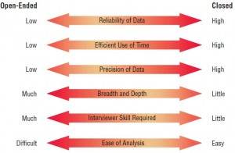
Interviews

Slide 19
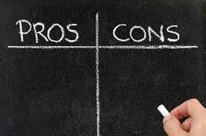
Interviews
Advantages of carrying out interviews
Provide qualitative information
Open –ended questions give the interviewee the opportunity to express themselves
Immediate follow-up or clarification is possible
It is easier to engage the interviewee
Drawbacks of carrying out interviews
Can be time-consuming and expensive
Only a limited number of people can be reached and contacted
Confidentiality may be an issue and the interviewee might not feel comfortable expressing his real views due to office politics

Slide 20
Interviews
Interviews are ideal to carry out when:
Obtaining general knowledge of what stakeholders do
Understanding how stakeholders might use the new system
Identifying the shortfalls of the current system
Interviews do poorly when :
Trying to elicit requirements about the organisational interactions
Trying to identify constraints because of organisational politics

Slide 21


Questionnaires
An information-gathering technique that allows responses, from a wide spread audience, to be quantified.
Questionnaires survey people’s:
Attitudes
Beliefs
Behaviour
Characteristics
These are often used to determine how widespread or limited a response expressed in an interview really is.

Slide 22
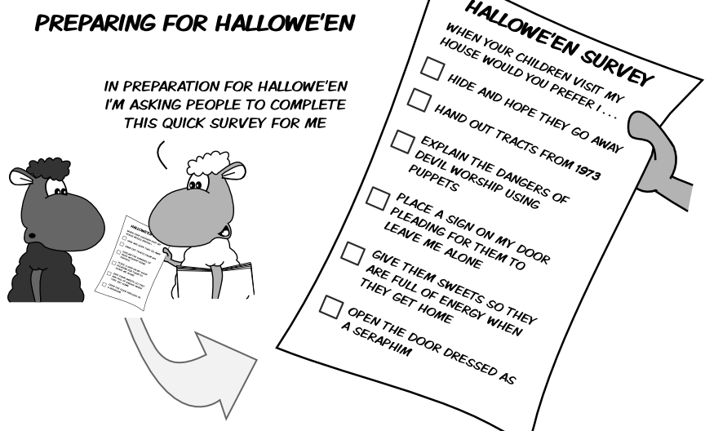
Questionnaires
They are often used to :
Grade the effectiveness of a system
Choose which functions should make it into the system
Recommend a system solution based on a particular software package
Questionnaires are ideal to carry out when:
Organization members are widely dispersed
Many members are involved with the project
Exploratory work is needed
Problem solving prior to interviews is necessary

Slide 23
Questionnaires
Advantages of carrying out Questionnaires
Not expensive to administer
Quick – gather information from many people in a relatively short time
Less bias in interpreting their results as these are easily quantified
Anonymous Questionnaires provide confidentiality
Drawbacks of carrying out Questionnaires
Do not yield as much information richness as other techniques
Not easy to detect people’s feelings based on quantitative information
Ambiguous questions might not be answered
Clarification of questions or answers is not possible

Slide 24
Prototyping
Prototyping can be very helpful in eliciting requirements and providing feedback.
This is because they give stakeholders something concrete to evaluate.
Hence :
Quality of customer feedback is improved
The chances of doing things right first time round are increased
The cost and development time of a system is reduced.
Developing prototypes hap hazardly and with out the proper planning may result in developing a prototype which is not effective enough in helping stakeholders understand what they require of the system.
Resources are still spent on producing prototypes so we should make sure that these return value for the investment made i.e. that they were worth developing!

Slide 25
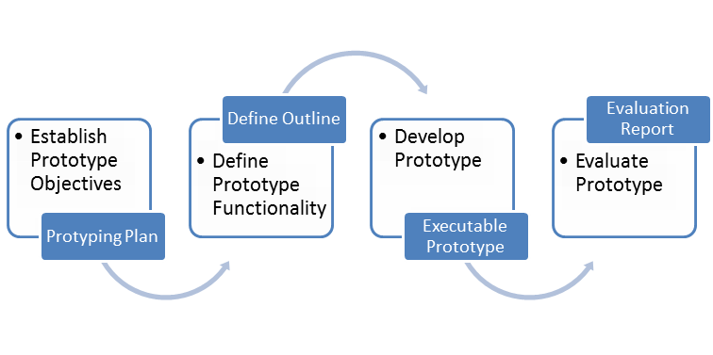
Prototyping
Prototype Development Process

Slide 26
Prototyping
There are 2 types of Prototypes : Throw-Away or Evolutionary
Throw-Away Prototypes
A simple working model of the system to visually show the users what their requirements may look like implemented as a system.
Eventually discarded and does not become part of the final system
A good technique to use for ‘proof-of-concept’ or for trying out new technologies.
Evolutionary Prototypes
The aim is for the prototype to form the heart of the new system.
It must be structured, robust and capable of being refined.
Prototypes are functional and may be used by the user until final system is delivered.
Gives users the opportunity to understand the system little by little

Slide 27
Prototyping
Throw-Away Prototypes, should never make it into the final System!
Once they have served their purpose they should be immediately discarded and a new system component is built using the information they provided.
Why?
Requirements related to performance, load and security may not be met as the prototype may not have been built with the best-practice architecture to support these.
Often the prototype is undocumented and this is problematic in the future
Quick changes and coding degrade the prototype structure making it less stable and more prone to bugs and crashes.
Quality standards are often not enforced.

Slide 28
Prototyping
Advantages of using Prototypes:
Encourages users to be actively involved in the development
Errors and Missing Functionality can be detected much earlier.
Quicker user feedback is available leading to better solutions.
Confusing or difficult functions can be identified
Working models help users get a better understanding of the system.
Drawbacks of using Prototypes:
It may lead to implement now – fix later way of building systems.
Complexity of the system is increased and scope expands beyond original plans.
Incomplete application may not to be used as the full system was designed
Can be costly if too much time is spent on their development

Slide 29
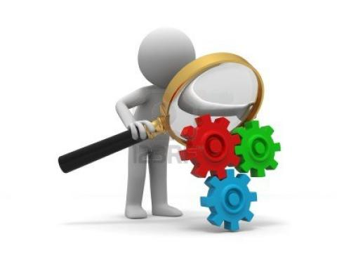
Observations
This method involves examining procedures as they are carried out i.e. observer witnesses first hand how the work is actually done and what it involves.
The observer takes a passive role and takes note of what he is seeing, this uncovers how tasks are actually being performed and which methods and tools are being used to carry these tasks out.
Information obtained from other investigation
techniques can be verified and discrepancies
between what should happen and what really
happens are brought to light.

Slide 30
Observations
Advantages of using Observations :
Users/managers often don’t remember everything they do so observations yield better information regarding work processes then descriptions.
Documentation may not specify well what really happens as this might not have been updated with the latest workflow processes.
Combined with prototyping, it may reduce the number of refinement cycles
Useful if no proper documentation of work flow processes exists.
Helps to identify inefficiencies and persistent problems which must be eliminated.
It is useful in timing how long activities take, so that the new system can shorten the time taken to carry out the process.

Slide 31
Observations
Drawbacks of using Observations :
Can be time consuming as a whole day has to be spent watching and taking notes.
Establishing when to observe a job / area may not be easy.
Behaviours can change when people are watched
Periodic activities such as end of month stock take may not be observed.
Observations focus on the end-user and my miss other organisational requirements

Slide 32
End of Lesson 2
Any questions?

